Slide 1
Traffic Management System
Gagliardo Miguel Angel
May 19th, 2025

Slide 2

Abstract
Smart traffic system using IoT, AI, RT Analytics
Mobile Apps, Information Panels, Control Centers
Optimizes flow, reduces travel time
Environmentally friendly

Slide 3
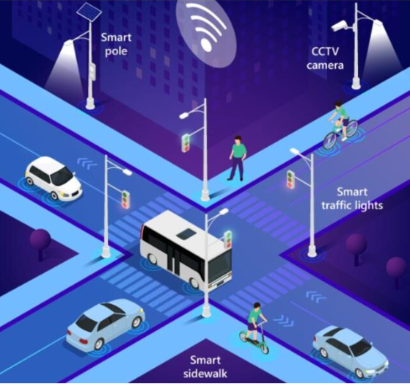
Introduction
Traffic congestion impacts QoL in Big Cities
Focus and Tailored on a per-city basis
Smart system to improve traffic flow, reduce pollution

Slide 4
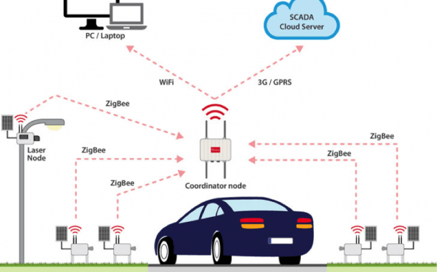
Approach
Requirement Analysis
System Design
Tech Implementation
System Integration
Testing & Validation

Slide 5
Conclusions
Improved traffic flow, reduced travel times, lower emissions
Pilot testing is recommended in selected areas and progressively expanding the implementation
Future collaboration with local authorities and integration with public transport systems will be crucial
Potential expansions include integrating machine learning for adaptive traffic control and blockchain for secure, transparent data handling.

Slide 6
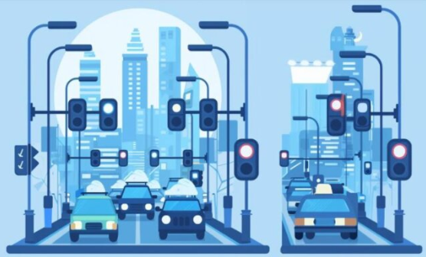
Implications
Technical Innovation
Sustainability
Smart Cities

Slide 7
References
Singh, A., & Jena, D. (2020). Leveraging Artificial Intelligence for Traffic Management: A Conceptual Framework. Journal of Urban Technology
Chen, S., & Lin, C. (2019). Intelligent Transportation Systems: A Comprehensive Review. IEEE Transactions on Intelligent Transportation Systems, 20(9), 3525-3549.
Breja, A., & Naik, N. (2018). Application of Sensor Technologies in Traffic Management: A Comprehensive Review. Proceedings of the 2018 International Conference on Advances in Electronics, Computers and Communications (ICAECC), 1-6.
Kulkarni, A., Gavade, A., & Patil, V. (2020). Applications of Artificial Intelligence in Traffic Management: A Review. International Journal of Advanced Research in Computer Engineering & Technology, 9(2), 521-532.

Slide 8
Questions?

